Slide 1




Lifemapper Provenance Virtualization
Nadya Williams (UCSD)
Aimee Stewart (KU)
Quan Zhou (IU)
Yuan Luo (IU)
Beth Plale (IU) Phil Papadopoulos (UCSD)

Slide 2


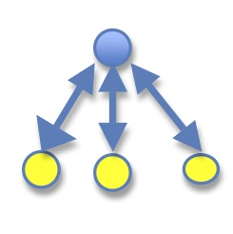
Outline
Cyber-infrastructure
Domain science
Provenance collection framework
Notes:
As part of the Virtual Biodiversity Expedition, we have joined
cyber-infrastructure, in the form of virtualized clusters for science applications, created at SDSC with
domain science, in the form of Lifemapper Species Distribution Modeling software, at KU, with
A provenance collection framework, called Karma, running at IU
This is a way of encapsulating the computation and ancillary activities, such as provenance capture, in an easily reproducible and deployable package

Slide 3
What are we trying to do
Domain scientist’s viewpoint
Show that Lifemapper is working in a new configuration
Gain information from current/archived jobs
Data scientist’s viewpoint
Captured provenance: generic elements and specific Lifemapper elements
Cyber-infrastructure viewpoint
Practical use of PRAGMA cloud
What is needed as a complete system – ease a burden of integrating hardware and software
What is missing and what can be useful
Notes:
Aggregation of data, experiments, results in a structured way
We want to reduce a cost of installing/configuring/replicating and provide an end-to-end solution

Slide 4

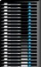
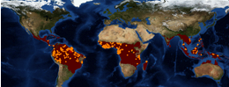
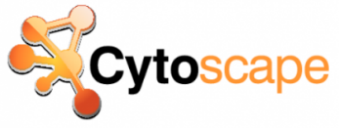
PRAGMA experiment with Virtual Clusters and metadata capture
Lifemapper user portal
University
of Kansas (KU)
UC San Diego (UCSD)
Indiana University (IU)
Submit species
modeling and
distribution
experiment
1
Overflow jobs
are sent
to Virtual Cluster
2
Lifemapper job
Results
sent to KU
3a
4
View experiment
provenance
Lifemapper virtual cluster
on PRAGMA cloud
Karma provenance repository
and analysis
Provenance Data
captured on VC,
sent to Karma
3b
Notes:
Testing does not “destroy” the Lifemapper server and a cluster can go down without ill effects on the server

Slide 5
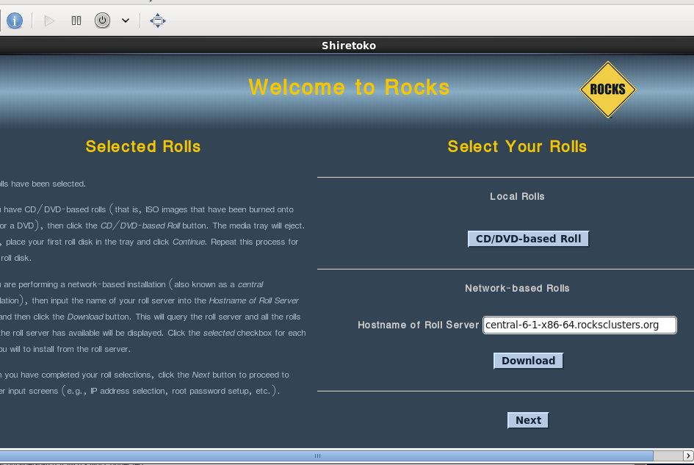
Building VC: regular rocks build
First incarnation
# rocks add cluster fqdn=”rocks-204.sdsc.edu” \
ip="198.202.88.201” fe-name=rocks-204 \
num-computes=2\
# rocks start host vm rocks-204
# virt-manager
# insert-ethers ( to install compute nodes)
# rocks start host vm hosted-vm0-0-0
Next rebuild
# rocks stop host vm rocks-204
# rocks set host boot rocks-204 action=install
# rocks start host vm rocks-204
# virt-manager
# rocks set host boot compute-0-0 action=install
# rocks run host compute reboot
compute
nodes
Notes:
Regular rocks virtual cluster build.
Need current hosting environment network info, available memory and disk size for the images
Can specify for cluster configuration: vlan, frontend disk image location (fe-container), memory, disk size
In order to support Virtual machines, it is necessary to have a particular network configuration on the hosting servers.
In particular bridges must be set up to provide Virtual Machine with network connectivity.

Slide 6
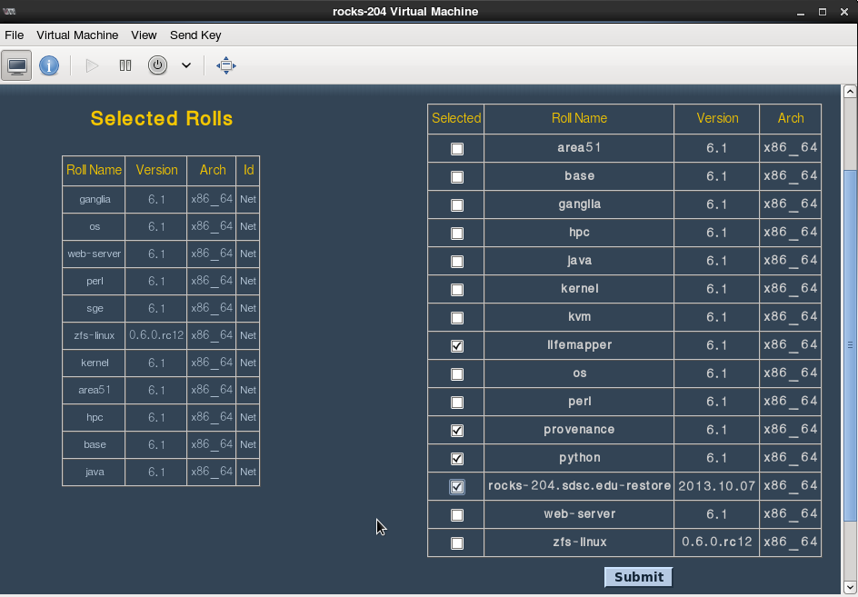
Building VC: add rolls
Notes:
All cluster installation and configuration and all software stack are captured with rolls.

Slide 7
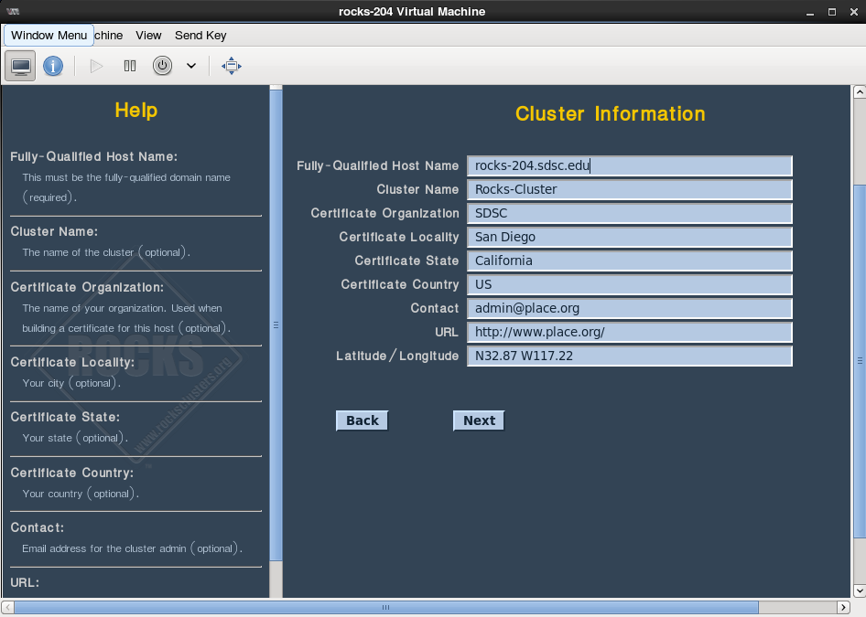
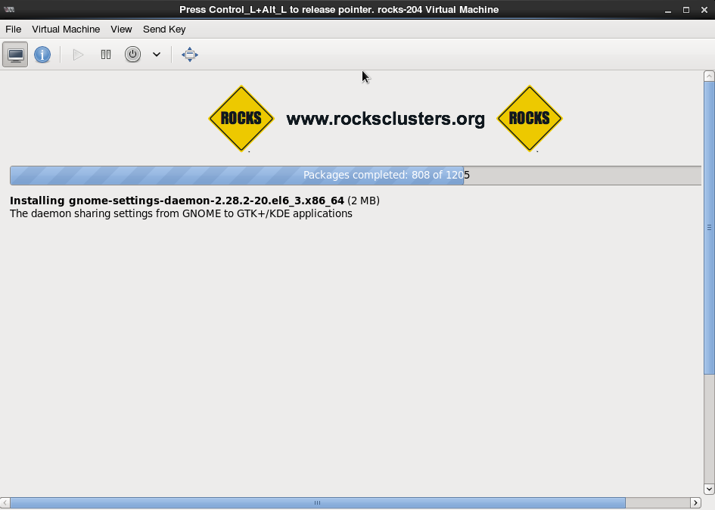
Building VC: cluster info
Notes:
Minimal information is needed
No “manual” work after packages installation: cluster comes up configured

Slide 8
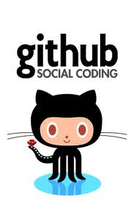
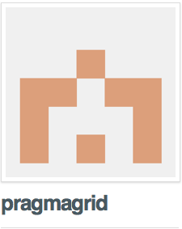
VC deployment – test stage
add Lifemapper roll
add Provenance roll
Test
Base cluster
Reinstall
https://github.com/pragmagrid/provenance/
https://github.com/pragmagrid/lifemapper/
Notes:
Most time is spent in making sure all new software is build and configured properly
Essential: have test cases for all installed software.

Slide 9
Virtual cluster key parts
Cluster
Lifemapper
Karma provenance tools
Rolls
Create and Deploy into existing environment
Dependencies: gdal, openmodeller, proj, tiff
Lifemapper compute module
Configuration
Karma server, client, adaptor, visualization plugin
Dependencies: erlang, rabbitmq, cytoscape
Virtual hosting environment
Configuration
Deploy into new environment
Rocks
frontend
compute
nodes
Software stack: rolls

Slide 10

Domain science
An archive of species distribution data
Web services for biodiversity research tools and data
LmSDM
LmRAD
Metadata for everything
Clients for easy access
Notes:
This experiment is the 3rd stage of the PRAGMA Virtual Biodiversity expedition. In the first 2 stages, we joined Lifemapper modeling with species data from Mount Kinabalu provided by Reed Beaman at University of Florida, and a client application accessing data and requesting processing at Indiana University, then cataloging results at the
Lifemapper can be described as 2 primary components, both accessible through web services
First, a set of observed and predicted species data and
Second, a set of research tools
Those tools consist of
species distribution modeling tools the distributions of individual species distributions and
Macro-ecology tools for looking at the qualities of a landscape of as described by a large number of species that inhabit it
All data and experiments in the system are accessible through the web services and we provide full metadata in the Ecological Metadata language, (EML)
We have written plugins to the free and open source Geographic Information system QGIS, as well as a scientific workflow system called VisTrails.

Slide 11
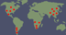



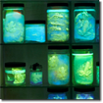



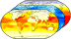
LmSDM: Species Distribution Modeling
Notes:
For this portion of the VBE, we are joining the LmSDM, Species Distribution Modeling System, with provenance capture and Nadya is assembling it all into a VC roll. Gabriel will describe the provenance capture, these are the basics of SDM modeling. We input
Species occurrence data, map coordinates of where a species has been found, with
Environmental data for those coordinates. In our case we are using temperature, precipitation, and elevation data, to create a model of the habitat best suited for the species, based on its known locations. We use OpenModeller software on our cluster to create these models. The models are then projected back onto maps of the environmental data to find other areas where the habitat is suitable for the species.
All of the modeling and map projecting takes place on our cluster. In this experiment, we did the modeling on the virtual cluster built by Nadya for Pragma.

Slide 12
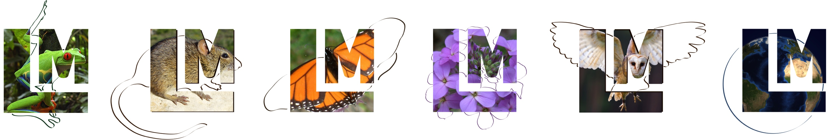
Notes:
Now I will show you how a researcher would request a model, using the Lifemapper plugin to QGIS.
This is an experiment which, under this scenario, with the provenance capture that Gabriel will show, would then be cataloged in the Karma system, with provenance on the both the inputs, outputs, Lifemapper analysis, and compute resource information.

Slide 13
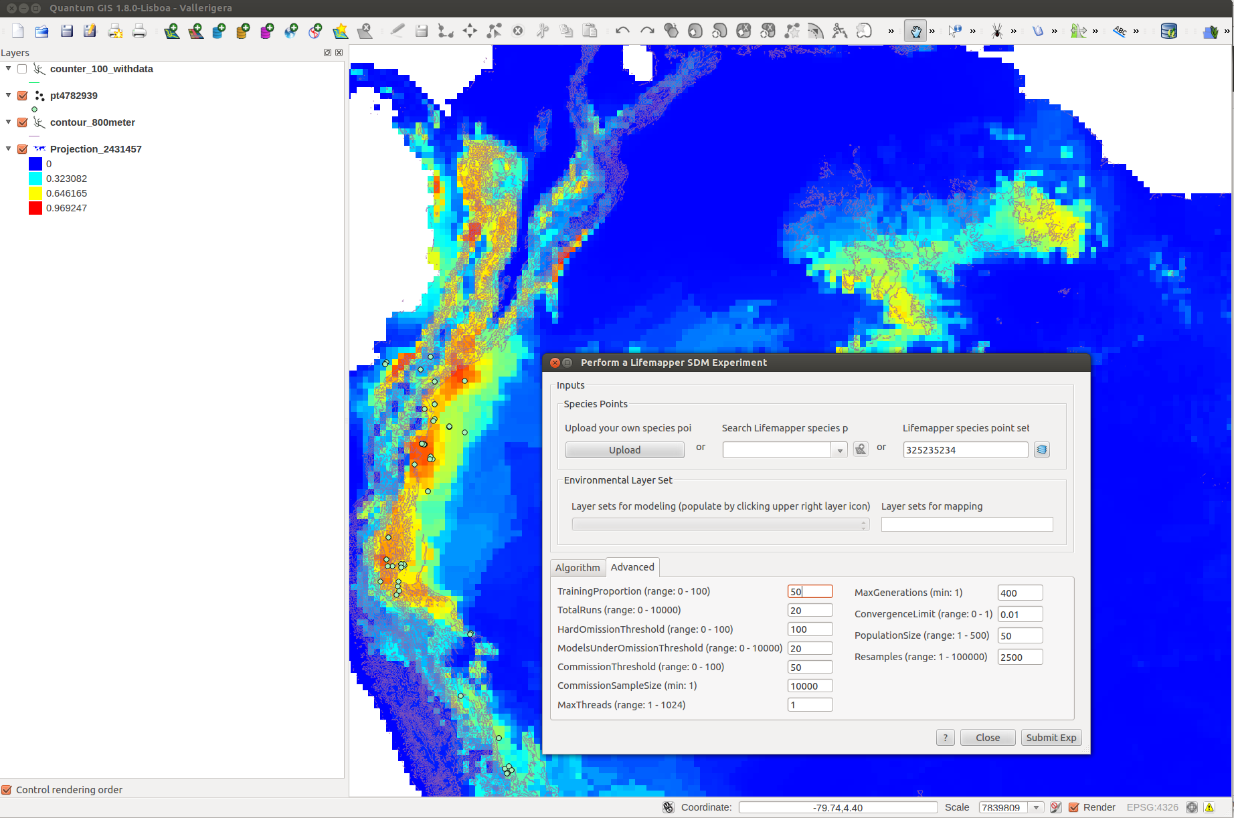
Submit a Lifemapper SDM experiment from QGIS

Slide 14
Provenance Collection Framework
Notes:
Provenance of digital scientific data is a critical component to broaden sharing and reuse of scientific data. For our case, Lifemapper expands its computing resources onto virtual machines running at San Diego Supercomputer Center (SDSC). This rich interdisciplinary application gives us the opportunity to study automated provenance capture as the biodiversity analysis is carried out and data products moved, consumed, and generated..

Slide 15
Why provenance?
Infrastructure VS Data
Failure Trace
Algorithm Versioning
Version Control
Enable Data Reuse
Data Lineage
Check Data Reliability
Data Quality
Notes:
Data lineage: can our provenance approach properly capture complete mappings between output data, input data and algorithms used to enable data reuse?
Data quality: can our provenance approach capture provenance sufficient to check input biodiversity dataset quality to verify the reliability of output data?
Version control: can our provenance approach capture algorithm or program versioning?
Failure trace: Can our provenance approach determine whether output dataset is affected by some infrastructure problems such as node failure, etc.?

Slide 16

Karma Provenance Collection Tool
Scientific Processing
Data Files
Log Files
Metadata
Other Sources
Karma Adaptor(s)
Rule
File
Event Notifications
Karma Visualization Client
Karma Service
Karma Retrieval and Visualization Plug-in
Provenance Events
Relational Provenance Store
Notes:
The Open Provenance Model (OPM) is a community-driven data model for Provenance that is designed to support inter-operability of provenance technology. Under OPM, is a notion of directed graph, used to represent data products and processes involved in past computations, and causal dependencies between these. It contains three kinds of nodes and five kinds of edges. Edges have specific source and specific destination. Foe example, Used has an Artifact as source, and a Process as destination.

Slide 17
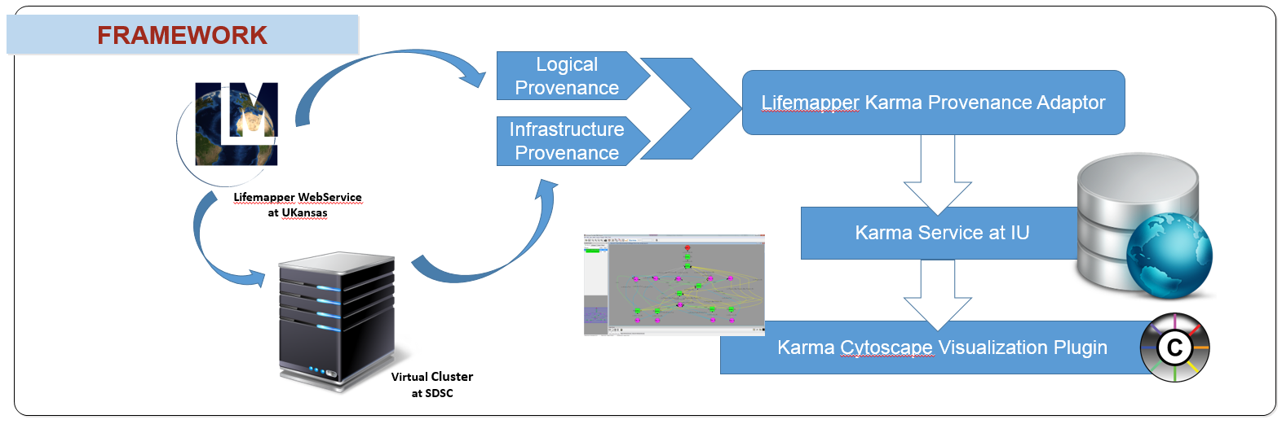
Framework
Notes:
The provenance information collected from LMPF consists of two provenance types: logical provenance and infrastructure provenance. Logical provenance consists of the input data items and executable program or function that creates an output data item inside one job. It can exactly provide users with provenance information about data lineage and version control. Moreover, logical provenance is stored at the granularity of files with the file identifier and metadata for each file. The warnings and errors such as missing parameters in the dataset can be recorded at this granularity level which can address the provenance challenge of checking data quality. Infrastructure provenance, on the other hand, is information about when a job is executed and what parts of the infrastructure were involved in the execution of the job. In this case, information includes machine hardware, software, and activity such as amount of memory, operating system and statistics regarding machine load, etc. This information can be used to address the provenance challenge of failure trace.
parse those log files, capture logical and infrastructure provenance for individual Lifemapper jobs, and aggregates provenance and metadata for the multiple jobs that form an experiment workflow; and 4) returns collected provenance back to the KARMA server at IU for storage. This provenance collection framework also provides users a Cytoscape Karma plugin to access and visualize the provenance information stored in the Karma server.

Slide 18
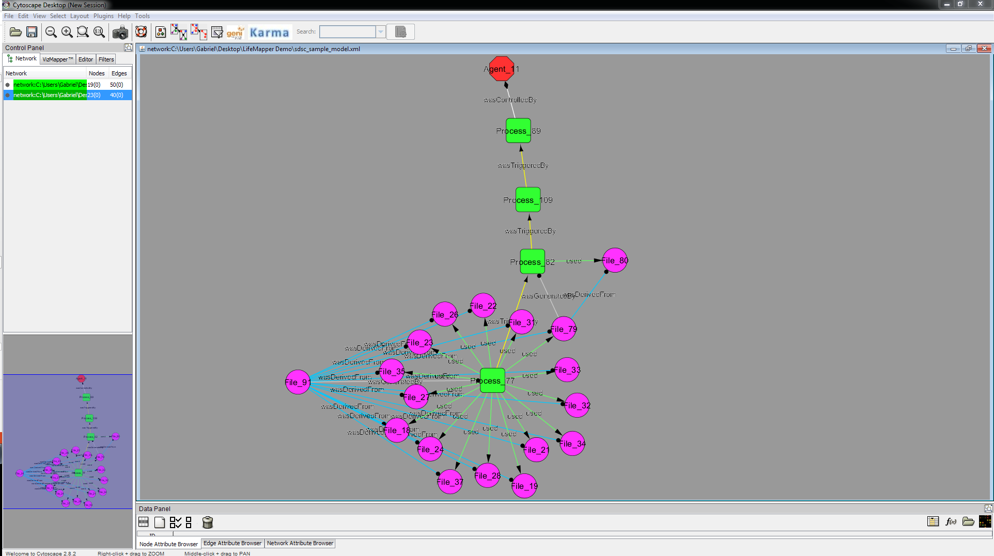
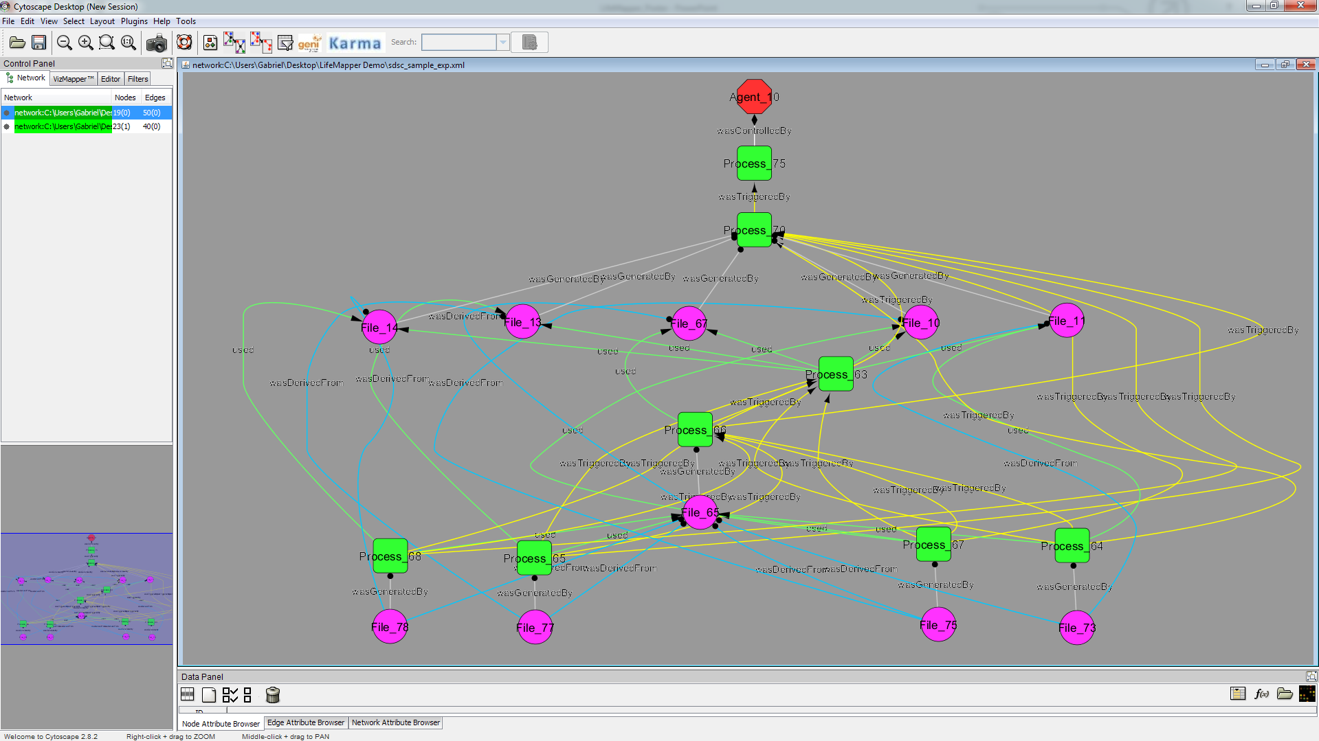


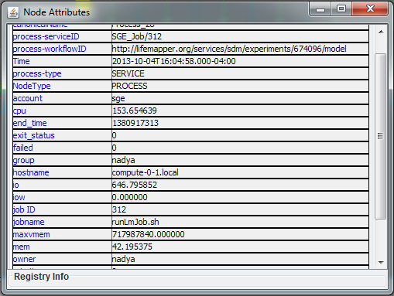
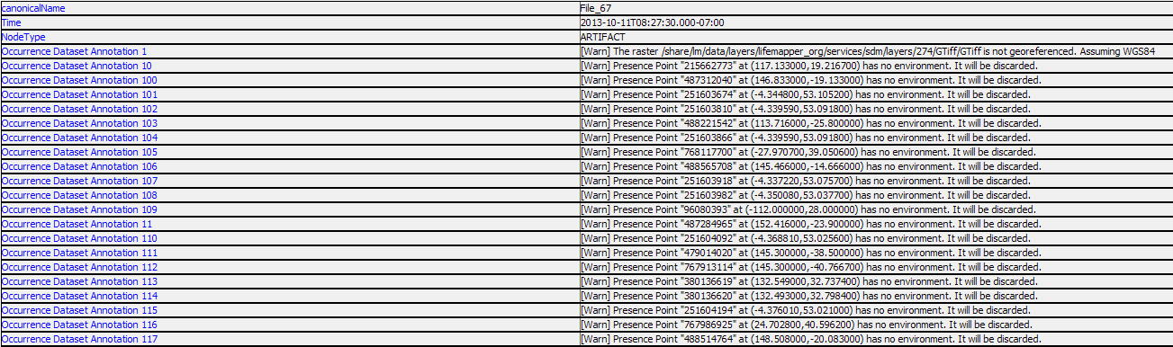
Demo

Slide 19
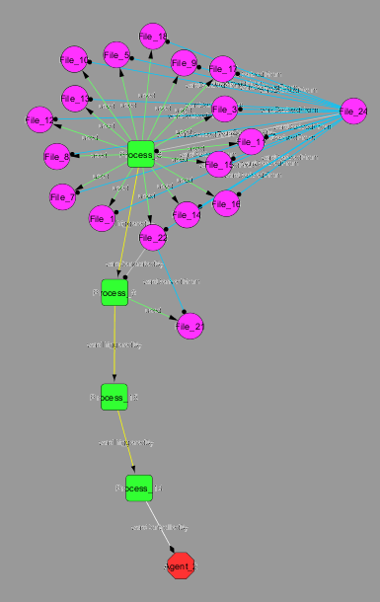
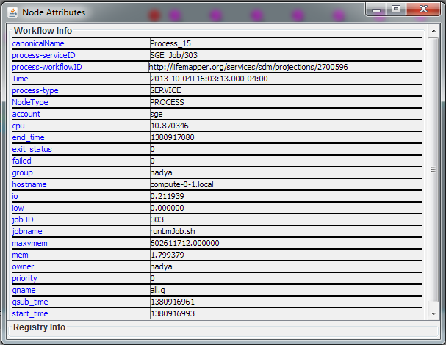
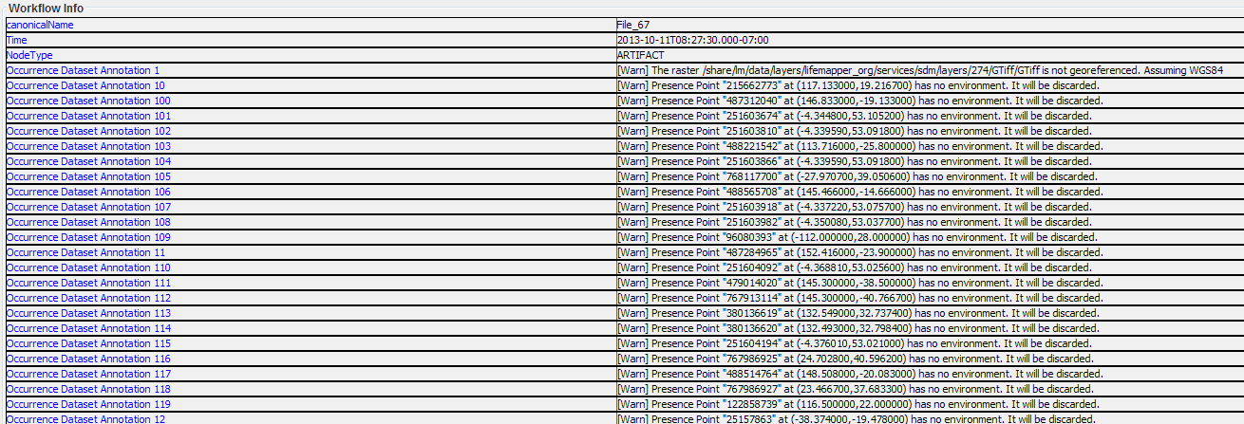
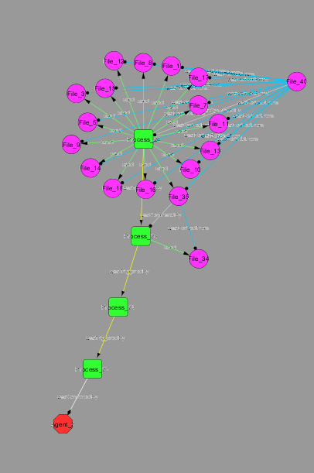
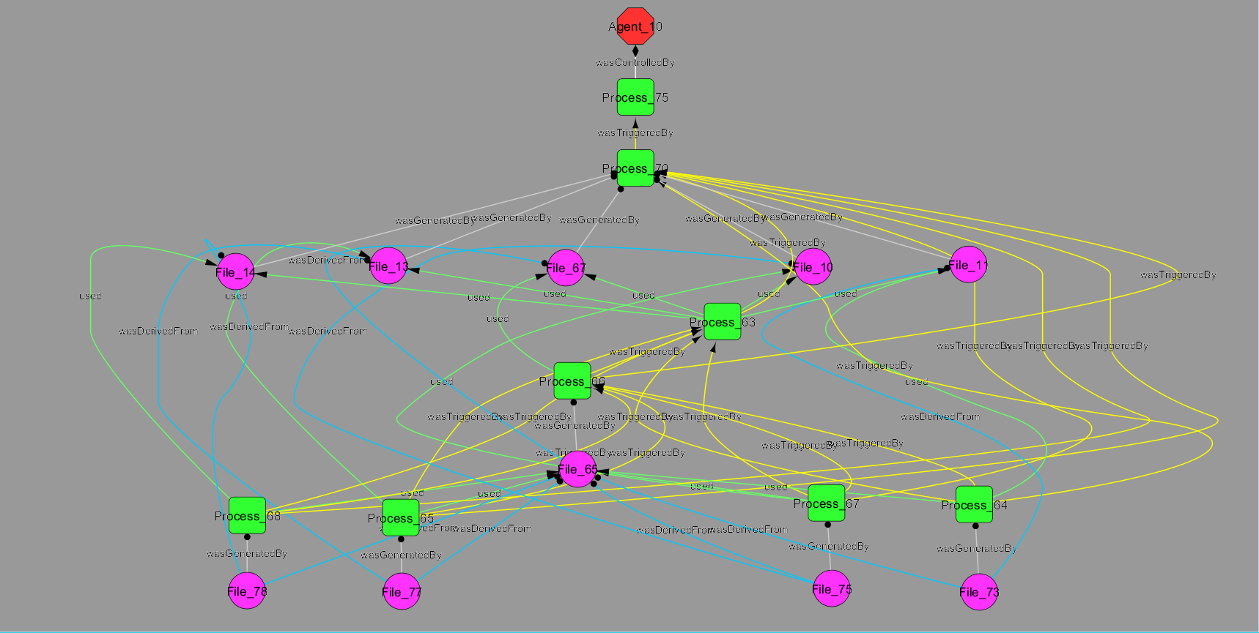
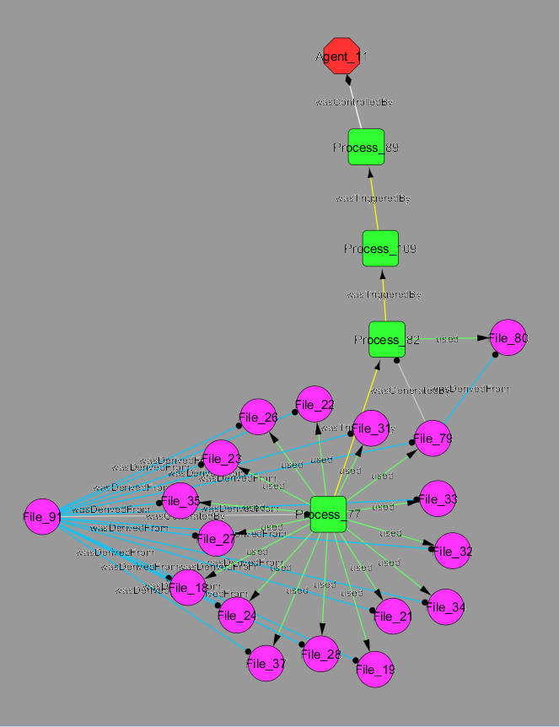
Component Process Provenance
Data Provenance
Process Provenance
Experiment Provenance

Slide 20
Future Work
Extending the Karma adaptor for Lifemapper to perform more system-based gathering of provenance
Migrating from Open Provenance Model (OPM) to the W3C PROV data model for provenance representation. PROV allows richer expression of relationships, semantic annotations and semantic inference

Slide 21
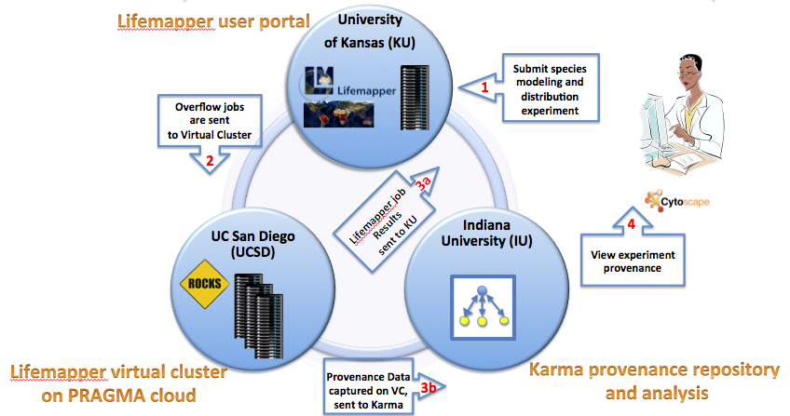

Conclusions
Results: it works !
Practical use of PRAGMA cloud in a distributed processing environment
Have a framework to meet our operational imperatives that can be used as a blueprint
Ease of replication
Lessons learned
What works in one environment may not apply in another
Multiple applications requirements, poor documentation
Best tools:
test
communicate
Notes:
Operational imperatives are 3 points of view:
domain scientists,
data scientists
cyber-infrastructure scientist
Cyber-infrastructure:
Connected infrastructure
Ease of replication
Scalability:
add more clusters
change Karma servers

Slide 22
Future work
Domain science
Include UTM data, metadata catalog
Use UFL high resolution Mt. Kinabalu imagery
Assemble multi-species macro-ecology experiment for the area
Cyber-infrastructure
Enable overlay network that can span Lifemapper server, Karma server and compute clusters
Can we handle data for specialized experiments – detached Lifemapper server usage
Can we handle different amounts of data?
Can we make it fault tolerant in the event of server/network outages?
Provenance collection framework
Extending the Karma adaptor for Lifemapper to perform more system-based gathering of provenance
Migrating from Open Provenance Model (OPM) to the W3C PROV data model for provenance representation. PROV allows richer expression of relationships, semantic annotations and semantic inference
Notes:
For the next iteration of our VBE, we would like to get back to the science experiment we began with – investigating the biodiversity of Mount Kinabalu in Borneo, Malaysia, incorporating and improving the computing infrastructure and provenance collection we demonstrated here today.
With higher quantity and quality of data, we will progress from simple single-species modeling experiments to run multi-species macro-ecology experiments with species distribution maps calculated from all the available Mt. Kinabalu species data and high resolution satellite imagery. These macro-ecology experiments will use the new LmRAD module to calculate maps and measures of various biodiversity indices.
We will further extend and test the portability of the new Lifemapper/Karma VC roll by deploying in 2 places, each for unique reasons.
The primary biodiversity scientist on this project, Reed Beaman at UFL, has just acquired high resolution satellite data that is restricted to UFL. We can deploy a Lifemapper compute cluster with the Karma adaptor at UFL to allow us to model with the satellite data without having to move it to another location. In other words, we will move the computing to the data, instead of the data to the compute engine.
In addition to the Lifemapper/Karma VC at UFL, another can be deployed at SDSC to run the computational multi-species macro-ecology experiments with species distribution maps calculated from all the available Mt. Kinabalu species data and high resolution satellite imagery. Experiments will be assembled to focus on the effects and expression of ultramafic soils (magnesium rich / calcium, potassium, and phosphorus poor) in this region of Borneo.
In addition, we would like to return to the Universiti Teknologi Malaysia, (UTM) by both cataloging all outputs in their Geoportal instance, and also querying them for available data inputs to experiments.
Provenance capture will then include a wider variety of input data, with restrictions on use and experiments composed of computations made at multiple pragma sites, and data housed at multiple pragma sites.
We will incorporate authentication and data restrictions into the communications and data/metadata access by requiring Karma to be configured with PRAGMA permissions through the more complex Lifemapper experiments

Slide 23


Acknowledgements
This work is funded in part by National Science Foundation and NASA grants
PRAGMA
US NSF 1234953
Karma provenance tools
US NSF ACI 1234983
US NSF ACI 1148359
Lifemapper
US NSF EPSCoR 0553722
US NSF EPSCoR 0919443
US NSF EHR/DRL 0918590
US NSF BIO/DBI 0851290
US NSF OCI/CI-TEAM 0753336
US NASA NNX12AF45A
Rocks
US NSF OCI-1032778
US NSF OCI-0721623

Slide 24
Links/Contacts
Lifemapper
http://lifemapper.org
https://github.com/lifemapper/
Karma Provenance Tools
http://d2i.indiana.edu/provenance_karma
http://sourceforge.net/projects/karmatool/
Rocks
http://www.rocksclusters.org
Pragmagrid GitHub
https://github.com/pragmagrid/provenance
https://github.com/pragmagrid/lifemapper
Nadya Williams
nadya@sdsc.edu
Aimee Stewart
astewart@ku.edu
Gabriel Quan Zhou
quzhou@indiana.edu
Yuan Luo
yuanluo@indiana.edu

Slide 25
Thank You!
Questions?

